Slide 1
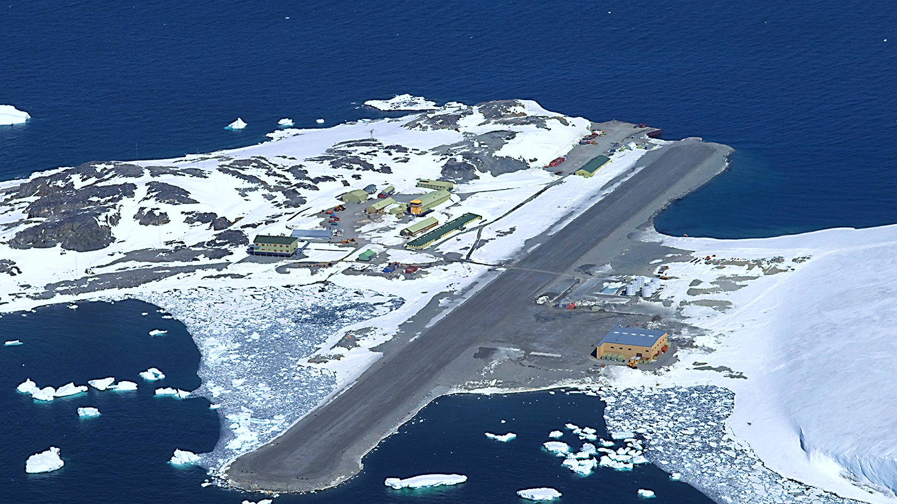
Optimising Remote Field Station Food Purchasing
Sophie Turner

Slide 2
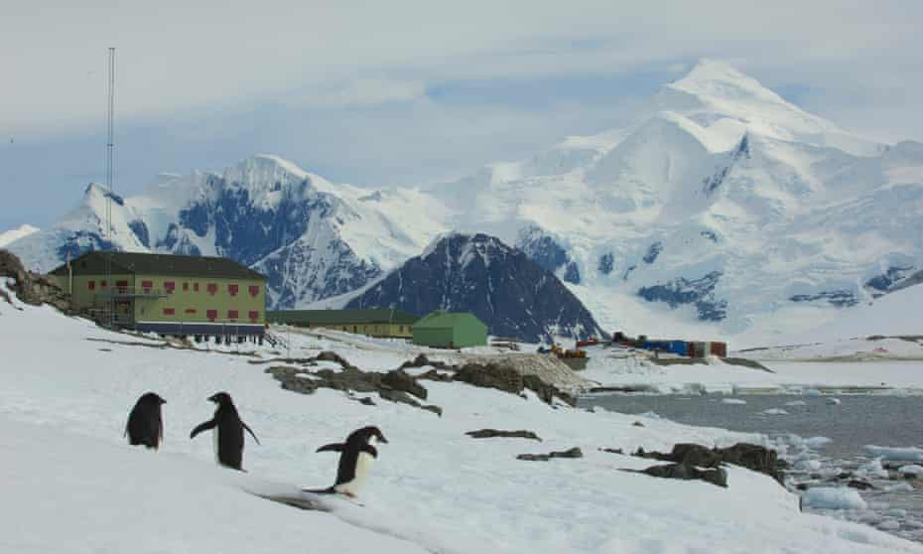

Rothera research station

Slide 3
Emissions Cost Food waste Packaging waste
Enjoyment
Variety
Nutrition
Allergies
Logistics

Slide 4
GWP = global warming potential kg CO₂e

Slide 5
The Future of Food in the Antarctic: a report prepared
for the British Antarctic Survey investigating the carbon
intensity of food supplied to an Antarctic research station
Edmund Dickens, 2021, University of Exeter
~ 263,919 kg CO₂e
~ 2 million km
~ 189 cars

Slide 7
Image references
Background picture - National Science Foundation. (2016). Rothera, the British Antarctic Survey station on the Antarctic Peninsula. Available: https://nsf.gov/news/mmg/media/images/Rothera%20station.jpg. Last accessed 5th Jul 2022.
Slide 2 - Bucktrout, P. (2020). Rothera on Adelaide Island. Available: https://www.theguardian.com/world/2020/nov/01/next-stop-antarctica-british-team-covid-free-coronavirus. Last accessed 5th Jul 2022.

